Slide 1
H&H Ltd.
Electronics Activation Systems
Product Portfolio
www.hamehaber.co.il, Info@hamehaber.co.il

Slide 2
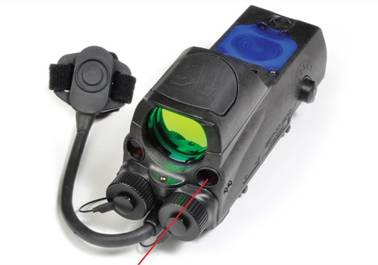
ABOUT US
Since 1959, H&H has been a high quality manufacturer of tactical products and components to the defense market.
We provide tailor made solutions to a variety of global customers including IDF, Rafael, Elbit Systems and Meprolight.
www.hamehaber.co.il, Info@hamehaber.co.il

Slide 3
Our Technology
Our manufacturing technology is based on a rubber molding process, resulting in state of the art products, combined with the most innovative technologies in the world.
The end-product is a waterproof and fireproof remote switch, which is also coated against breakage and different chemicals. It is most resilient in harsh conditions.
The mechanical components of the product are of supreme quality; the rubber mixture is lengthy processed that provides a perfect solution in harsh combat environments.

Slide 4
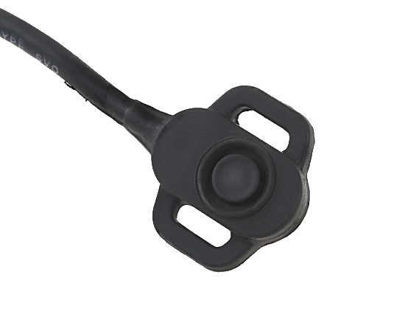
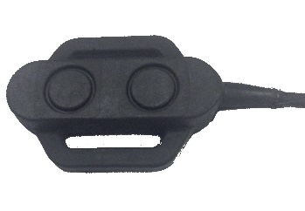
PTT Product – 51 Line
A rubber molded remote switch with straps for velcro. Designed for tightening on claps – semi low-profile.
Our traditional rubber molded switch but with 2 independent clicking surfaces that enables to operate both light and laser. With rubber straps to attach Velcro for mounting – semi low-profile.
Combat-Proven
Can be implemented with 3 kinds of cables:
Coaxial cable.
Mil-Spec cables – M27500.
Carolprene Cable.

Slide 5
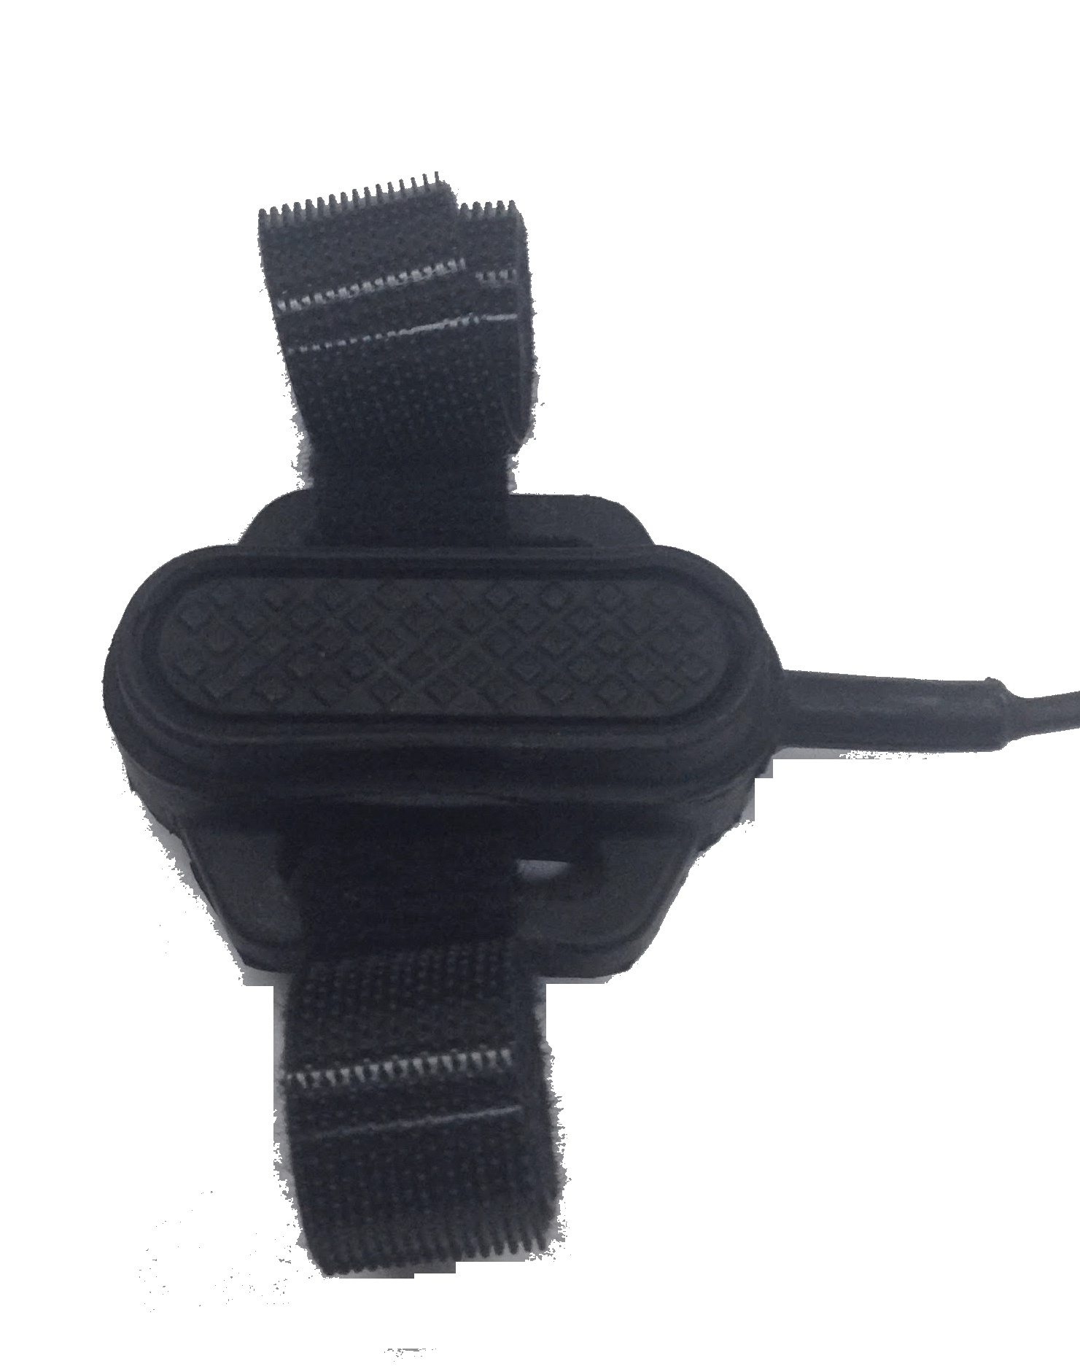
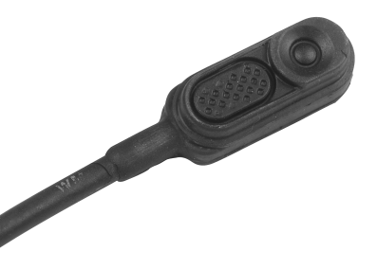
PTT Product – 53 Line
A rubber molded remote switch with metal plate and straps for velcro –
enables wider activation surface.
This line has a relative advantage – enables clicking from any angle and in any part of the PTT.
A rubber molded dual-function remote switch with straps for velcro– semi low-profile.
1st - sunk in to prevent accidental activation.
2nd - molded with a long metal plate - extending the activation surface.

Slide 6
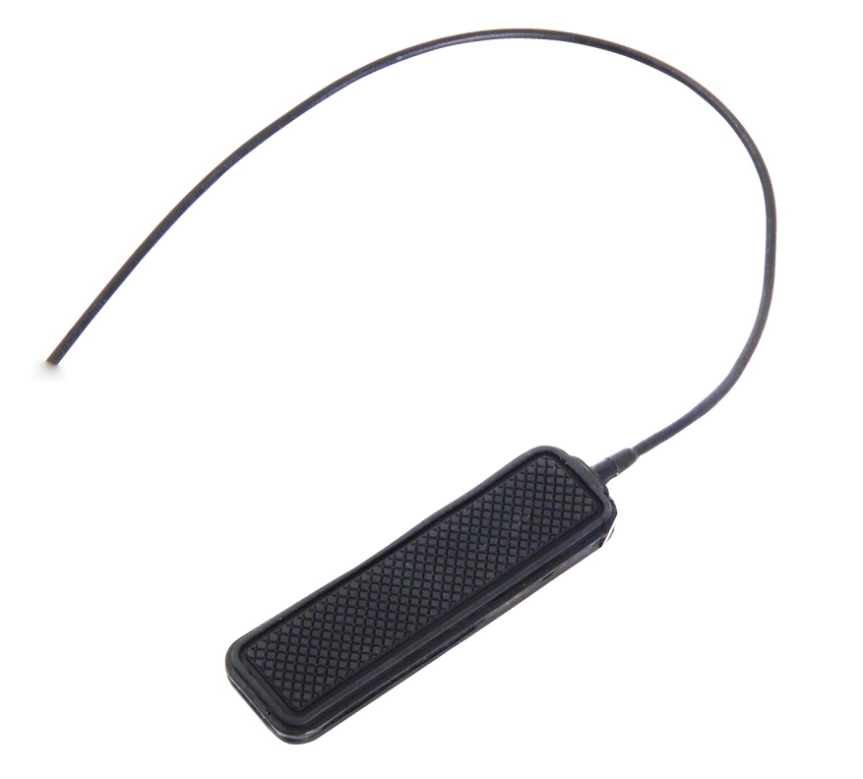
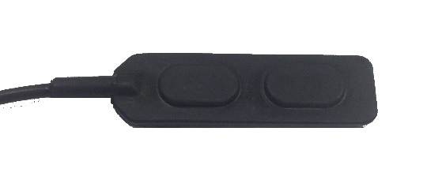
PTT Product – 54 Line
H & H switch pad – developed and designed to remain the combat-proved technology but in a low-profile style - super low-profile.
H & H dual-function switch – with the advantages of our combat-proven technology but in a low-profile style, with 2 independent clicking surfaces that enables to operate both light and laser - super low-profile.

Slide 7
H&H Ltd.
The competitor
Technology
Inner Switch/es
High quality switch , controlled pressure clicking.
PCB membrane switch with metal dome.
✓
X
Material
Unique neoprene mixture. Results in properties such as: Durability, fireproof, flexibility, High chemical resistance.
Thermoplastic Elastomeric.
✓
~
Adhesive
Lengthy processed glue, provides perfect adhesive between cable and switch, which prevents short circuits.
PTT is molded on a cable, which makes the adhesive less resilient.
✓
X
Tactical
Geometry
Enables clicking from any angle and in any part of the PTT.
Including spaces without clicking area.
✓
X
Tactical Feel
Perfect tactical feel, results in good feedback during combat conditions.
Good tactical feel, provides moderate feedback to the warrior.
✓
~
Notes:
Product Comparison table template with three product column

