Slide 1
H&H Ltd.
Electronics Activation Systems
Product Portfolio
www.hamehaber.co.il, Info@hamehaber.co.il

Slide 2
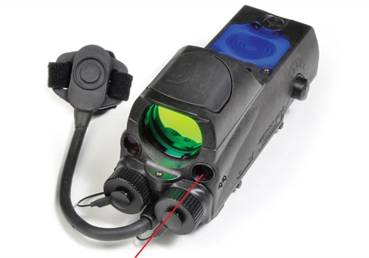
ABOUT US
Since 1959, H&H has been a high quality manufacturer of tactical products and components to the defense market.
We provide tailor made solutions to a variety of global customers including IDF, Rafael, Elbit Systems and Meprolight.
www.hamehaber.co.il, Info@hamehaber.co.il

Slide 3
Our Technology
Our manufacturing technology is based on a rubber molding process, resulting in state of the art products, combined with the most innovative technologies in the world.
The end-product is a waterproof and fireproof remote switch, which is also coated against breakage and different chemicals. It is most resilient in harsh conditions.
The mechanical components of the product are of supreme quality; the rubber mixture is lengthy processed that provides a perfect solution in harsh combat environments.

Slide 4
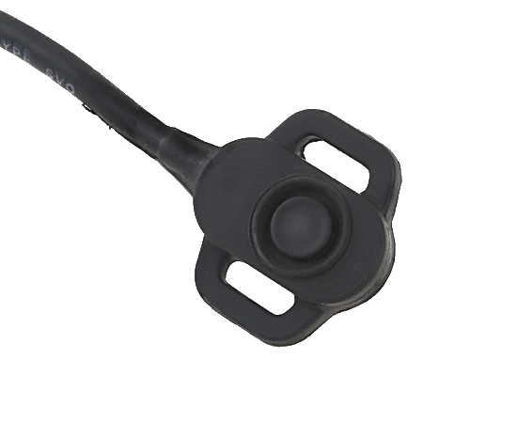
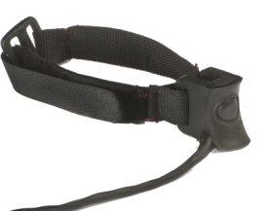
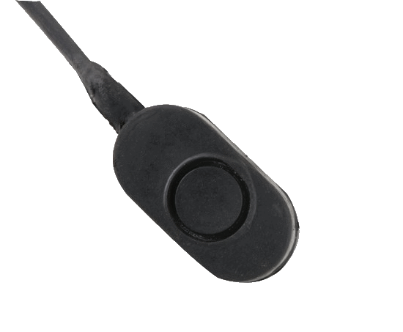
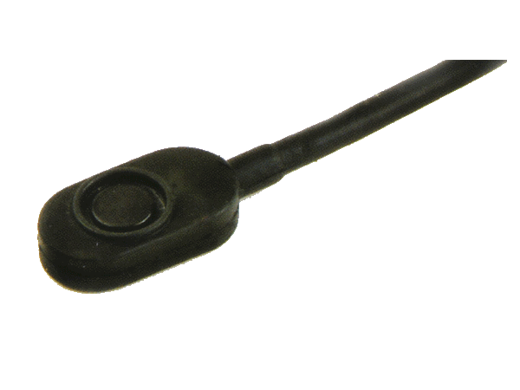
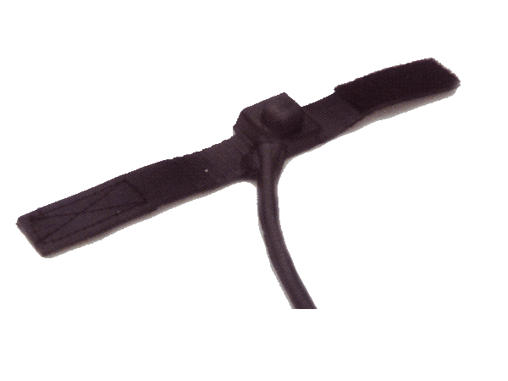
PTT Product Offering
A rubber molded remote switch with straps for velcro. Designed for tightening on claps.
A rubber molded remote switch for Laser
engagement system (Miles). Suited for all weapons, such as the M16 and the Tavor
A rubber molded remote switch (N.CLOSE, N.OPEN). For thin cable.
A rubber molded remote switch (N.CLOSE, N.OPEN). For thick cable.
A rubber molded remote switch with straps.

Slide 5
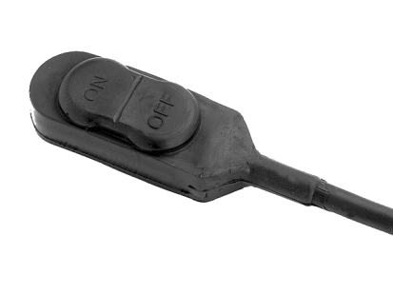
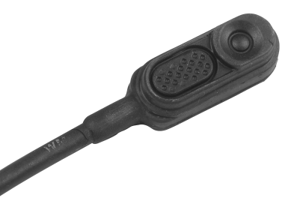
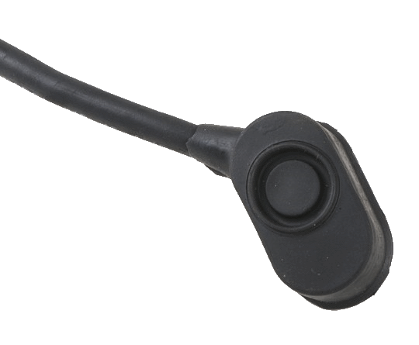
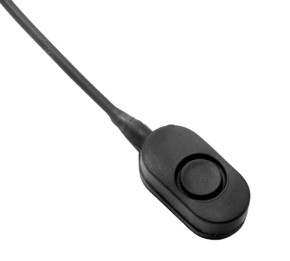
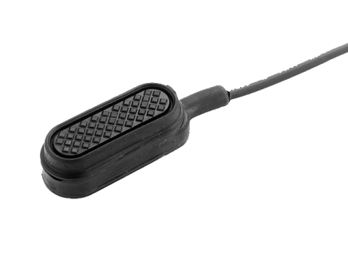
PTT Product Offering
On/Off rubber molded remote switch.
A rubber molded remote switch
with an angle of 45 degrees.
A rubber molded remote switch with two independent switches:
1st - sunk in to prevent accidental activation.
2nd - molded with a long metal plate - extending the activation surface.
A tiny rubber molded remote switch.
A rubber molded remote switch with metal plate –
enables wider activation surface.
This model has a relative advantage – enables clicking from any angle and in any part of the PTT.

